Slide 1
Lecture 14 Hydrogen chemistry

Slide 2
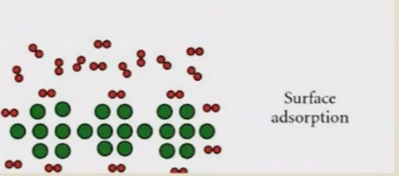
ADSORIYVION: MECHANISM
• Van der Waals attraction between H2
molecule and a material with a large specific
surface area
• Material selection will be based on the
surface area
High surface area = high H2 storage capacity
• Low temperatures and elevated pressures
typically be applied to achieve significant
hydrogen storage
• Materials: Metal Organic Framework (MOF),
Zeolites, Carbon (SWNT, AC, MWNT etc.)

Slide 3
METAL HYDRIDES
• Elemental metal hydrides (MgH2, TiH2, AlH3 etc.)
• Intermetallic hydrides (TiFeHx, LaNi5Hx etc.)
• Complex metal hydrides (LiBH4, NaAlH4 etc.)

Slide 4
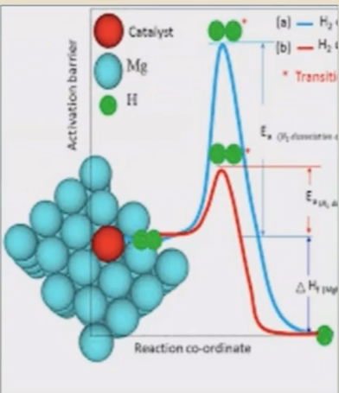
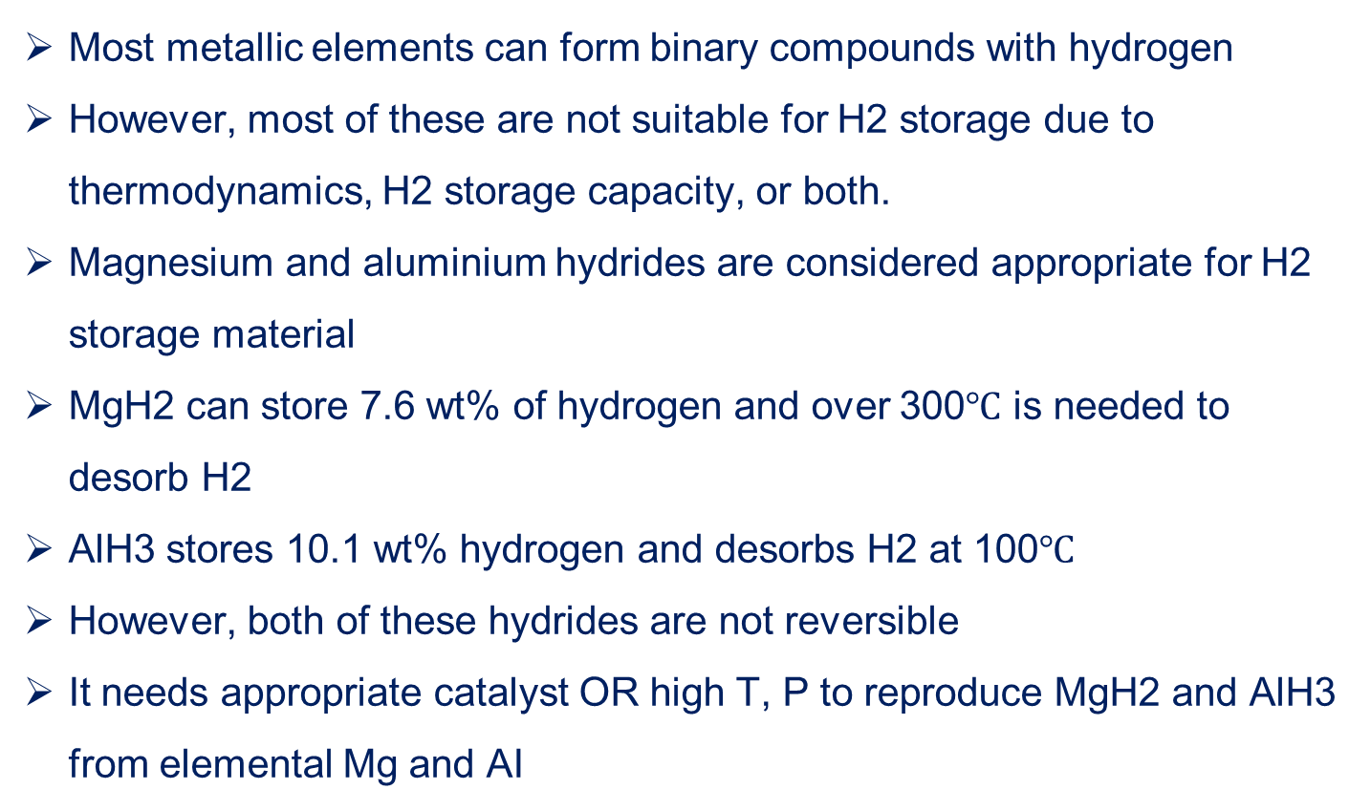
ELEMENTAL METAL HYDRIDES (MHx)
Most metallic elements can form binary compounds with hydrogen
However, most of these are not suitable for H2 storage due to thermodynamics, H2 storage capacity, or both.
Magnesium and aluminium hydrides are considered appropriate for H2 storage material
MgH2 can store 7.6 wt% of hydrogen and over 300$℃$ is needed to desorb H2
AlH3 stores 10.1 wt% hydrogen and desorbs H2 at 100$℃$
However, both of these hydrides are not reversible
It needs appropriate catalyst OR high T, P to reproduce MgH2 and AlH3 from elemental Mg and AI

Slide 5
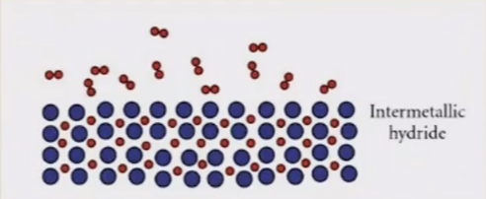
INTERMETALLIC HYDRIDES (AxBYHz)
Two metal A & B are chosen such that A binds H strongly and B binds H weakly
Type: AB (TiFe) , AB2 (Mg2Ni), AB5 (LaNi5)
H forms solid solution with the intermetallic compd.
These systems shows reversibility at ambient condition
2 ABHX 2AB + XH2
However, storage capacity is very low (around 2 wt%)
LaNi5 is successfully used in NiMH battery

Slide 6
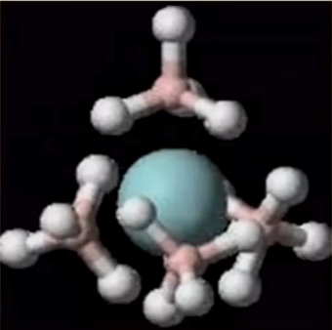
COMPLEX METAL HYDRIDES (A+ BHX-)
• In complex metal hydrides, hydrogen is present as a part of a complex anion (BHx-) that is in turn bonded to a metallic cation (A+)
• Three major types of complex hydrides are suitable for H2 storage
Alanate (AlH4-), Borate (BH4-), Amide (NH2-)
• Complex hydrides are made of comparatively lighter (B, N, Al) elements & accordingly storage capacity is quite higher (>10 wt%)
• Issue: High decomposition T & NOT reversible
• Use of catalysts can reduce the decomposition temperature

Slide 7
CHEMICALS
Liquid Organic Hydrogen Carrier (Organic cyclic compounds)
Other chemicals (NH3, methanol, Formic acids etc.)

Slide 8
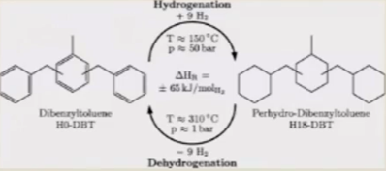
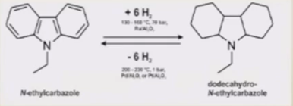
LIQUID ORGANIC HYDROGEN CARRIER (I.OHC)
• Liquid at ambient condition both hydrogenated and dehydrogenated compound
• Reversible (reversibility is achieved in LOHCs via the saturation and unsaturation of carbon-carbon bonds)
• Storage capacity: 5— 6 wt%
• Need noble metal catalysts and high temperature

Slide 9
OTHER CHEMICALS
• Methanol (CH30H), ammonia (NH3), and formic acid (HCOOH) are
mostly referred in this category
• Advantages: Produced in bulk, No transport/ storage issue, Large
scale storing option
• If renewable/green H2 is used to produce, then use of NG will
come down
• Also, for methanol & formic acid, atmospheric C02 can be used
for production
• Issue: Decomposition is energy intensive for NH3 and CH30H,
Formic acid has low H2 storage capacity (4.4 wt%), Need to
store/capture C02 or N2 after decomposition

Slide 10


HYDROGEN BOTTLENECK: AS PER DOE TARGETS
Parameter | DOE target | Adsorbents | Transition MH | Intermetallic Complex | Complex Hydrides | Chemicals
Gravimetric capacity (wt%) | 65
Volumetric density (kg/L) | 0.05
System cost ($/kg H2) | 266
Operating temperature | -40/60
Operating pressure (bar) | 5/12
Cycle life (no. of cycles) | 1500
Refuelling time | 5 | X (Slow) | X Too Slow | X Too Slow | X Too Slow

Slide 11
LARGE SCALE HYDROGEN STORAGE
Mostly stored in purest form as hydrogen gas or liquid
• Gaseous storage:
Underground storage (stored in caverns, salt domes, or depleted gas/oil fields)
Hydrogen storage tanks (Compressed)
• Cryogenic storage: Liquid hydrogen stored in tanks

Slide 12
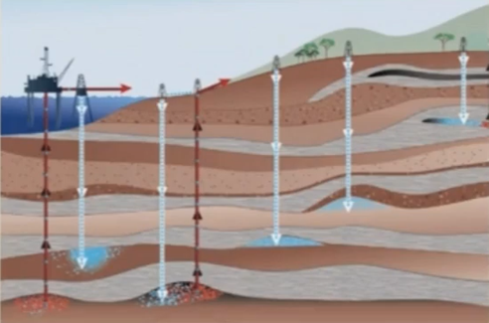
UNDERGROUND HYDROGEN STORAGE
The reservoirs must have
higher porosity
permeability, and
a reliable cap rock to ensure that the gas does
not leak vertically
Prior to hydrogen injection into aquifers, draining away of pore water is needed, and the storage is built up just beneath the
non- permeable water-bearing cap rock.
For salt caverns, usually a thickness of 9—90 m of salt layer is needed. Cave is created by injecting water and dissolving salt. Later salt water is removed and hydrogen is injected.

Slide 13
Thank You

